Slide 1
Digital Portfolio
STUDENT NAME: S.Harjeet
REGISTER NO AND NMID: 2428M0010/FDE83253493CA7B865D4B37832091B5D
DEPARTMENT: Bsc DataScience
COLLEGE/ UNIVERSITY: Kumaraguru College of Liberal Arts and Science/ Bharathiyar University

Slide 2
PROJECT TITLE
Interactive digital portfolio using FWD

Slide 3


AGENDA
Problem Statement
Project Overview
End Users
Tools and Technologies
Portfolio design and Layout
Features and Functionality
Results and Screenshots
Conclusion
Github Link
3/21/2024 Annual Review

Slide 4

PROBLEM STATEMENT
Traditional paper-based portfolios are static, difficult to update, and hard to share, limiting their effectiveness in showcasing students' achievements. They don’t allow interactive content or easy customization. To address these issues, digital portfolios built with modern Frontend Web Development (FWD) technologies offer a creative, interactive, and easily updatable solution. This enables students to present their skills and accomplishments more dynamically and accessibly.

Slide 5

PROJECT OVERVIEW
This project is a web-based interactive digital portfolio application developed using Frontend Web Development (FWD). It enables students to showcase their academic projects, skills, and extracurricular achievements. The portfolio features engaging layouts and multimedia elements like images and videos. It has a responsive design that works well across devices. Students can easily update their content without technical difficulties. This provides a more creative and dynamic way to present their work compared to traditional paper portfolios. Overall, it helps students highlight their strengths effectively to potential employers or academic institutions.

Slide 6

WHO ARE THE END USERS?
1)Students seeking to showcase their skills and achievements
2)Job recruiters and HR professionals
3)College faculty and placement officers
4)Admission committees for higher studies

Slide 7

TOOLS AND TECHNIQUES
HTML
CSS
JavaScript
Code Editor (Codepen)

Slide 8
POTFOLIO DESIGN AND LAYOUT
The portfolio showcases a modern dark-themed design, offering a sleek and professional look. It uses a clean color scheme, pairing a dark background with light text and bright blue accents for headings, creating a clear visual hierarchy. The site follows a single-page layout with a sticky navigation bar, making it easy to navigate through sections. Content is arranged in well-structured blocks, including a three-column grid for project cards, ensuring easy browsing. The design emphasizes user experience, featuring a responsive layout and a simple, uncluttered interface that works seamlessly on both desktop and mobile devices.
8

Slide 9
FEATURES AND FUNCTIONALITY
Homepage:
The homepage acts as a welcoming landing page, introducing the portfolio owner, S. Harjeet. It features a prominent heading with a personal introduction and a “View My Work” button that directs visitors to the projects section. A sticky navigation bar at the top provides easy access to Home, About, Projects, and Contact sections, ensuring smooth navigation across the site.
About Me:
I specialize in developing data-driven solutions using Python and Excel. My mini project involves creating a Public Health Dashboard based on NFHS-4 & NFHS-5 data. It analyzes indicators like literacy, clean fuel usage, birth registration, and health insurance across Indian states. The project highlights progress and gaps, using Python (Pandas, Matplotlib, Seaborn) for data cleaning, visualization, and Excel for structured reporting. I focus on delivering actionable insights to support research, policy, and academic work

Slide 10
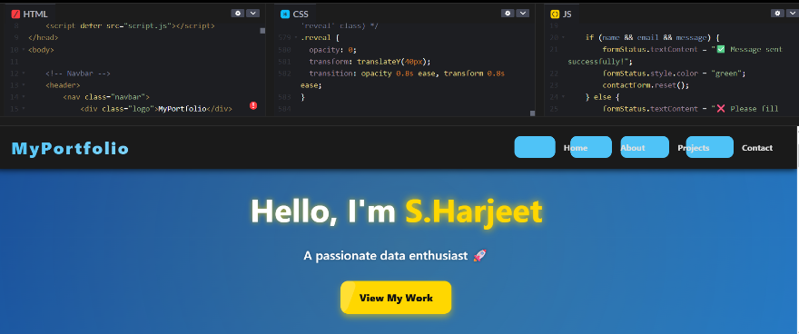
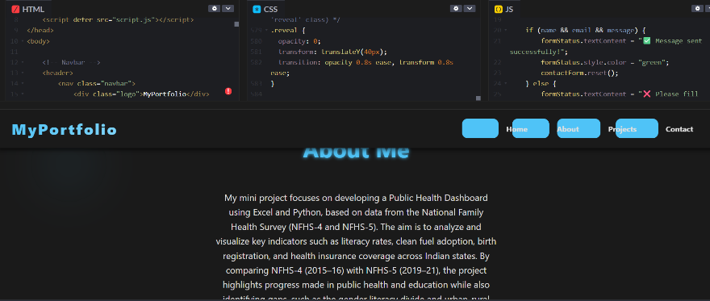

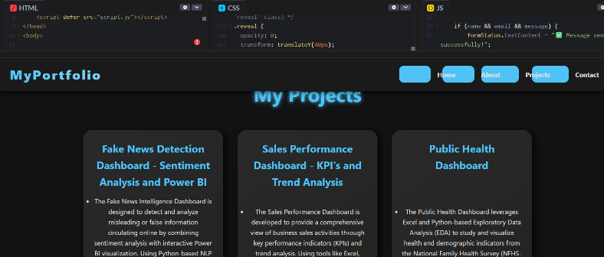
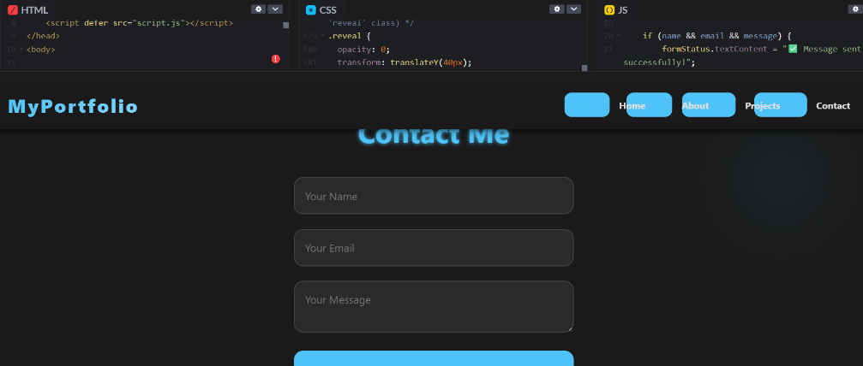
RESULTS AND SCREENSHOTS
3/21/2024 Annual Review
10

Slide 11
CONCLUSION
The Interactive Digital Portfolio Using FWD effectively overcomes the drawbacks of traditional static portfolios by providing a flexible, visually engaging, and interactive platform for students and professionals. Leveraging modern Frontend Web Development (FWD) frameworks, this project enables users to easily update, personalize, and showcase their academic and extracurricular accomplishments.
This digital portfolio system simplifies the creation process while ensuring a fully responsive design that performs well on all devices. Features like multimedia integration, live previews, and customizable sections enhance the user's online presence, making a strong impact on recruiters, faculty, and other key audiences.
Additionally, practical functionalities such as GitHub integration, resume downloads, and intuitive customization options offer valuable tools for employability and personal branding. The project also opens the door for future improvements, such as adding analytics to monitor portfolio visits or enabling interactive communication with recruiters.
In summary, the project illustrates how FWD-powered digital portfolios represent a significant advancement for modern career development, encouraging creativity and professionalism in personal presentation.
11

